Slide 1

Parallel Programming in C with MPI and OpenMP
Michael J. Quinn

Slide 2
Chapter 9
Document Classification

Slide 3
Chapter Objectives
Complete introduction of MPI functions
Show how to implement manager-worker programs

Slide 4
Outline
Introduce problem
Parallel algorithm design
Creating communicators
Non-blocking communications
Implementation
Pipelining

Slide 5
Document Classification Problem
Search directories, subdirectories for documents (look for .html, .txt, .tex, etc.)
Using a dictionary of key words, create a profile vector for each document
Store profile vectors

Slide 6
Document Classification Problem

Slide 7
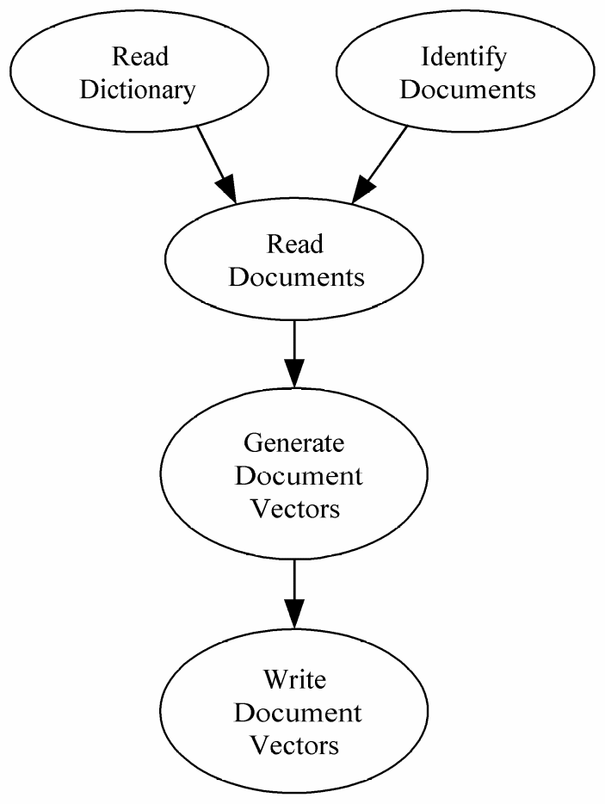
Data Dependence Graph (1)

Slide 8
Partitioning and Communication
Most time spent reading documents and generating profile vectors
Create two primitive tasks for each document

Slide 9
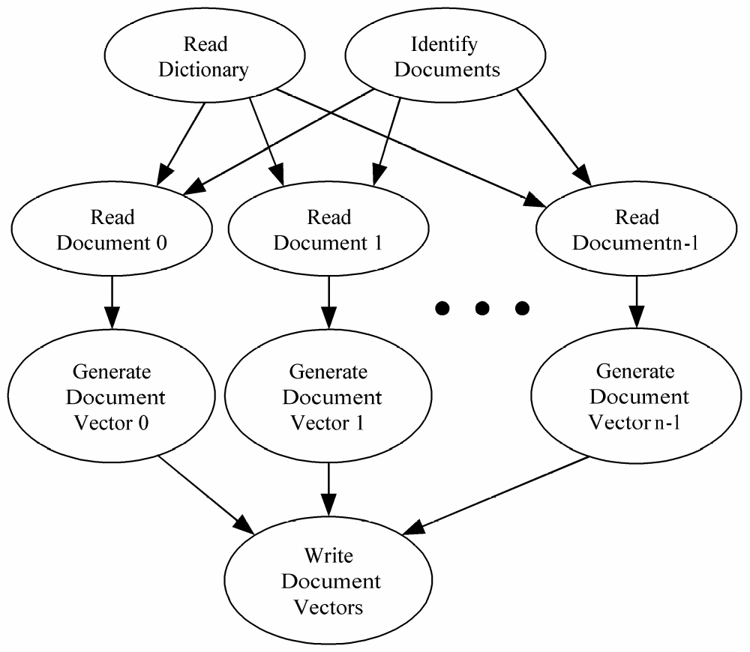
Data Dependence Graph (2)

Slide 10
Agglomeration and Mapping
Number of tasks not known at compile time
Tasks do not communicate with each other
Time needed to perform tasks varies widely
Strategy: map tasks to processes at run time

Slide 11
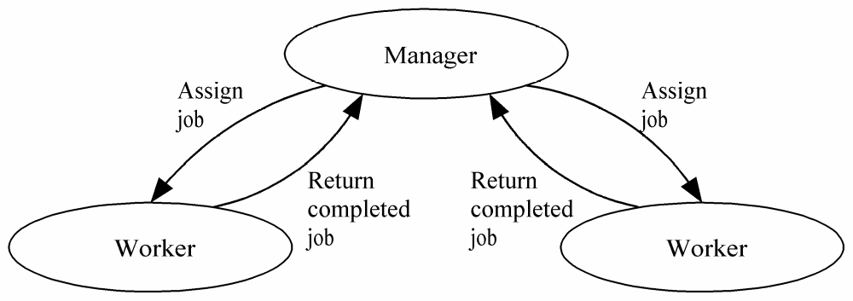
Manager/worker-style Algorithm
Can also be viewed as domain partitioning with run-time allocation of data to tasks

Slide 12
Manager/Worker vs. SPMD
SPMD (single program multiple data)
  Every process executes same functions
  Our prior programs fit this mold
Manager/worker
  Manager process has different responsibilities than worker processes
  An MPI manager/worker program has an early control flow split (manager process one way, worker processes the other way)

Slide 13
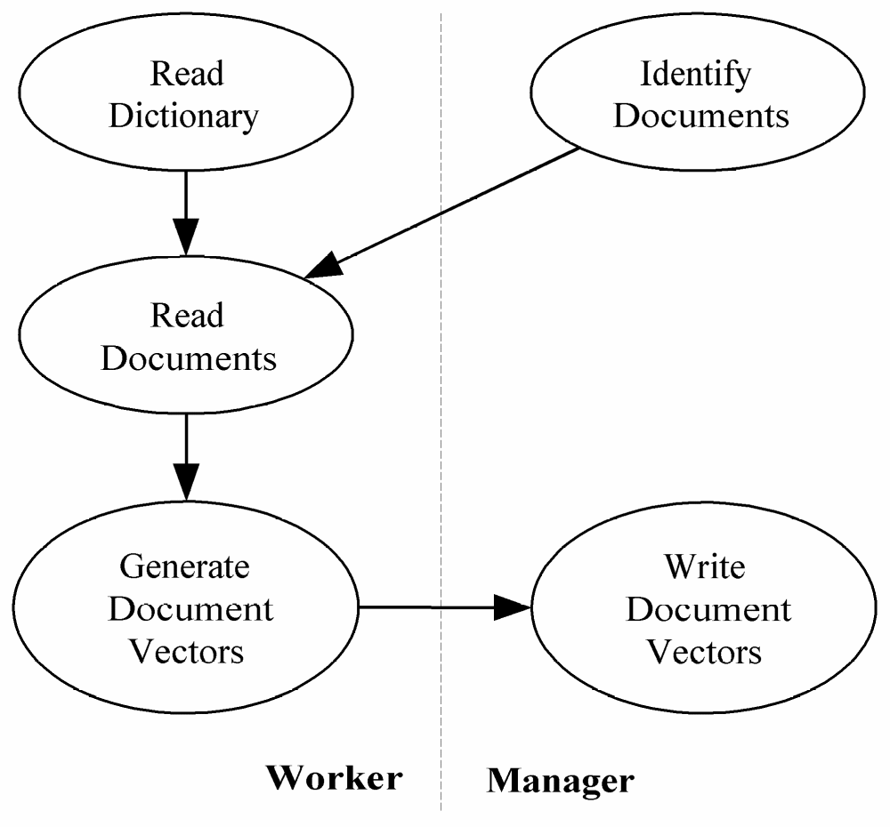
Roles of Manager and Workers

Slide 14
Manager Pseudocode
Identify documents
Receive dictionary size from worker 0
Allocate matrix to store document vectors
repeat
Receive message from worker
if message contains document vector
Store document vector
endif
if documents remain then Send worker file name
else Send worker termination message
endif
until all workers terminated
Write document vectors to file

Slide 15
Worker Pseudocode
Send first request for work to manager
if worker 0 then
Read dictionary from file
endif
Broadcast dictionary among workers
Build hash table from dictionary
if worker 0 then
Send dictionary size to manager
endif
repeat
Receive file name from manager
if file name is NULL then terminate endif
Read document, generate document vector
Send document vector to manager
forever

Slide 16
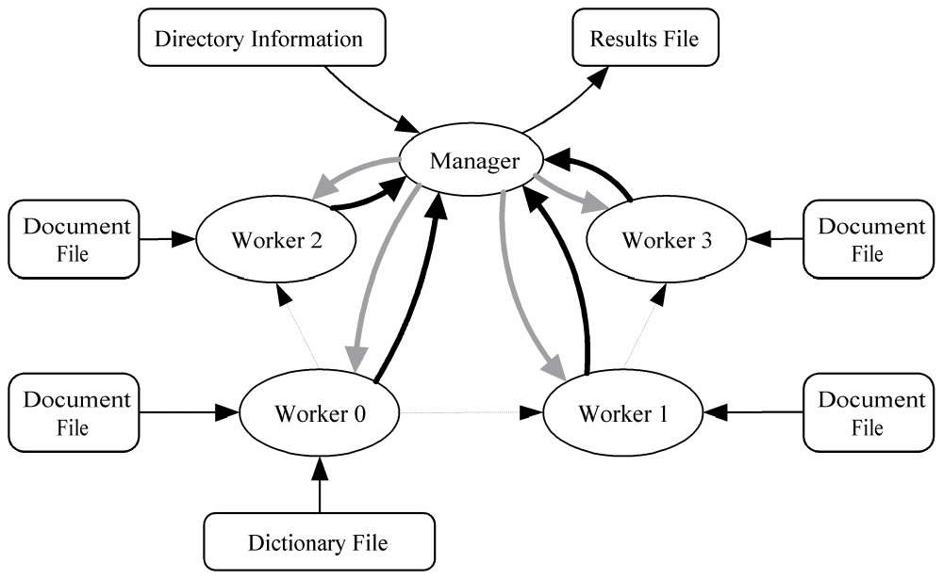
Task/Channel Graph

Slide 17
MPI_Abort
A “quick and dirty” way for one process to terminate all processes in a specified communicator
Example use: If manager cannot allocate memory needed to store document profile vectors

Slide 18
Header for MPI_Abort
int MPI_Abort (
MPI_Comm comm, /* Communicator */
int error_code /* Value returned to
calling environment */
)

Slide 19
Creating a Workers-only Communicator
Dictionary is broadcast among workers
To support workers-only broadcast, need workers-only communicator
Can use MPI_Comm_split
Manager passes MPI_UNDEFINED as the value of split_key, meaning it will not be part of any new communicator

Slide 20
Workers-only Communicator
int id;
MPI_Comm worker_comm;
...
if (!id) /* Manager */
MPI_Comm_split (MPI_COMM_WORLD,
MPI_UNDEFINED, id, &worker_comm);
else /* Worker */
MPI_Comm_split (MPI_COMM_WORLD, 0,
id, &worker_comm);

Slide 21
Nonblocking Send / Receive
MPI_Isend, MPI_Irecv initiate operation
MPI_Wait blocks until operation complete
Calls can be made early
  MPI_Isend as soon as value(s) assigned
  MPI_Irecv as soon as buffer available
Can eliminate a message copying step
Allows communication / computation overlap

Slide 22
Function MPI_Irecv
int MPI_Irecv (
void *buffer,
int cnt,
MPI_Datatype dtype,
int src,
int tag,
MPI_Comm comm,
MPI_Request *handle
)
Pointer to object that identifies
communication operation

Slide 23
Function MPI_Wait
int MPI_Wait (
MPI_Request *handle,
MPI_Status *status
)

Slide 24
Function MPI_Isend
int MPI_Isend (
void *buffer,
int cnt,
MPI_Datatype dtype,
int dest,
int tag,
MPI_Comm comm,
MPI_Request *handle
)
Pointer to object that identifies
communication operation

Slide 25
Receiving Path Name
Worker does not know length of longest path name it will receive
Alternatives
  Allocate huge buffer
  Check length of incoming message, then allocate buffer
We’ll take the second alternative

Slide 26
Function MPI_Probe
int MPI_Probe (
int src,
int tag,
MPI_Comm comm,
MPI_Status *status
)
Blocks until message is available to be received

Slide 27
Function MPI_Get_count
int MPI_Get_count (
MPI_Status *status,
MPI_Datatype dtype,
int *cnt
)

Slide 28
Enhancements
Middle ground between pre-allocation and one-at-a-time allocation
Pipelining of document processing

Slide 29
Allocation Alternatives
Time
Load imbalance
Excessive
communication
overhead
1
n/p
Documents Allocated per Request

Slide 30
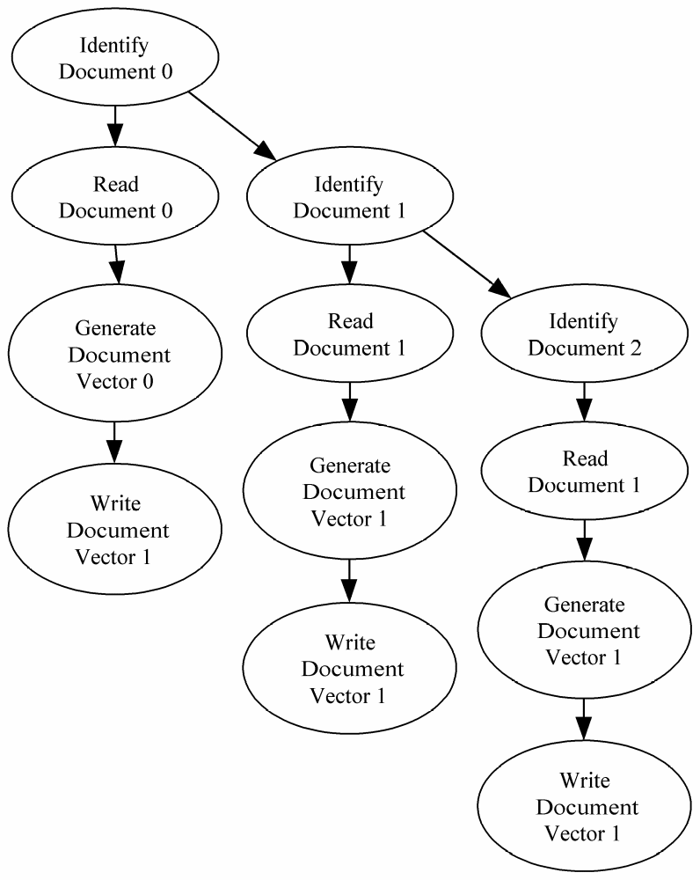
Pipelining

Slide 31
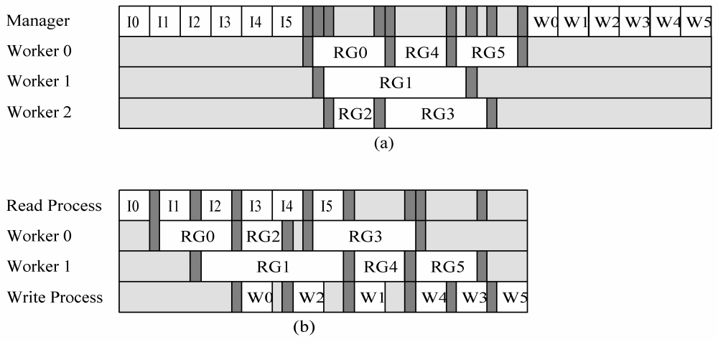
Time Savings through Pipelining

Slide 32
Pipelined Manager Pseudocode
a ← 0 {assigned jobs}
j ← 0 {available jobs}
w ← 0 {workers waiting for assignment}
repeat
if (j > 0) and (w > 0) then
assign job to worker
j ← j – 1; w ← w – 1; a ← a + 1
elseif (j > 0) then
handle an incoming message from workers
increment w
else
get another job
increment j
endif
until (a = n) and (w = p)

Slide 33
Function MPI_Testsome
int MPI_Testsome (
int in_cnt,
/* IN - Number of nonblocking receives to check */
MPI_Request *handlearray,
/* IN - Handles of pending receives */
int *out_cnt,
/* OUT - Number of completed communications */
int *index_array,
/* OUT - Indices of completed communications */
MPI_Status *status_array
/* OUT - Status records for completed comms */
)

Slide 34
Summary
Manager/worker paradigm
  Dynamic number of tasks
  Variable task lengths
  No communications between tasks
New tools for “kit”
  Create manager/worker program
  Create workers-only communicator
  Non-blocking send/receive
  Testing for completed communications

